Slide 1
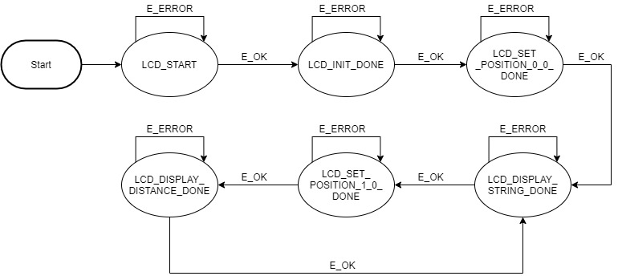
State Machine
DisplayDistance

Slide 2
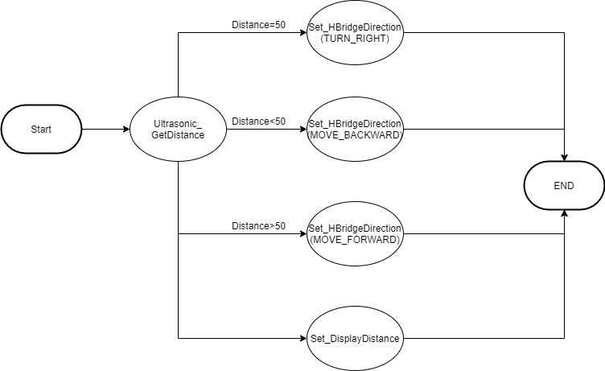
State Machine
GetDistance

Slide 3

State Machine
HBridgeControl

Slide 4
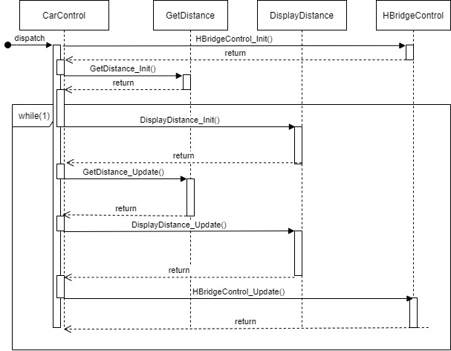
Process Diagram

Slide 5
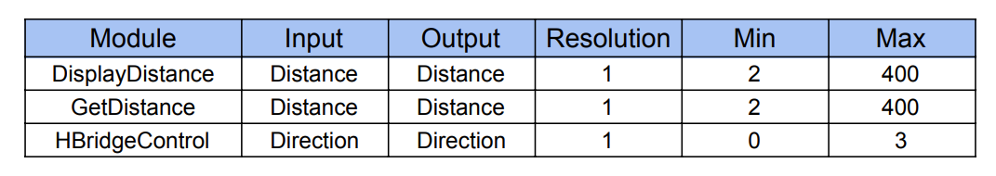
Inputs and Outputs

Slide 6
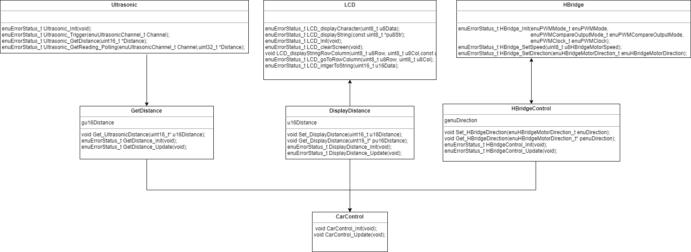
Class Diagram

